Slide 1
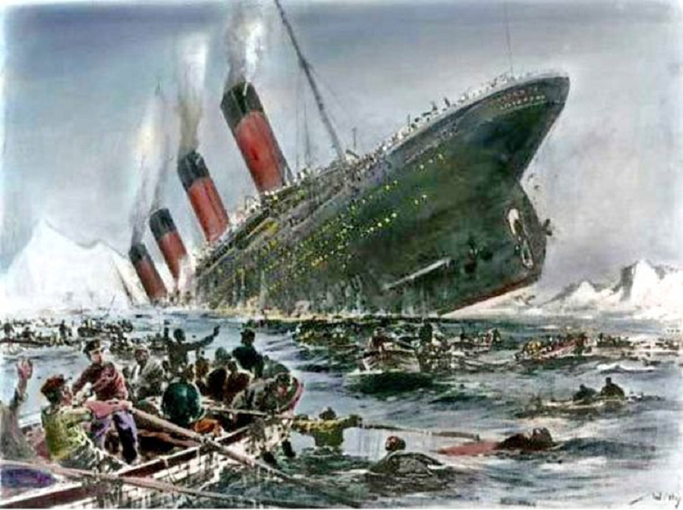

Predicting Titanic Survivors using Machine Learning: An Analysis of the Titanic Dataset
Abdul Aziz Ramzan
160920748310

Slide 2

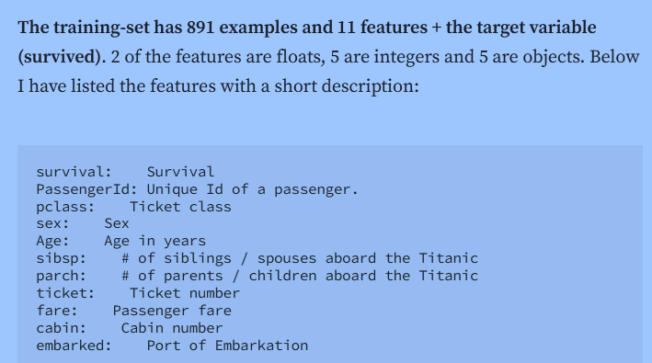
Dataset Overview
In this presentation, we will be analyzing the Titanic disaster dataset to uncover the truth about the no. of people who survived . We will examine various factors that contributed to the sinking of the ship and the loss of lives. Our goal is to get the exact no. of survivors those were present in the ship.

Slide 3
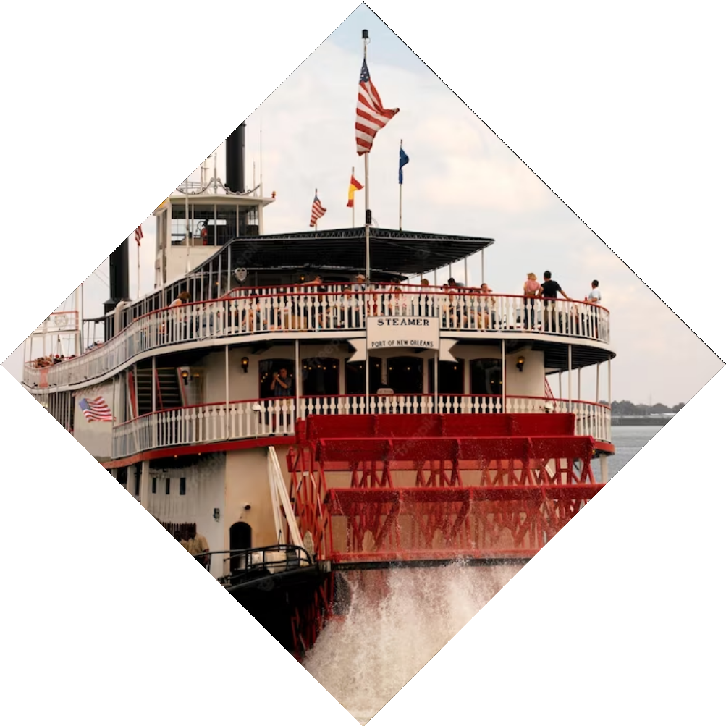
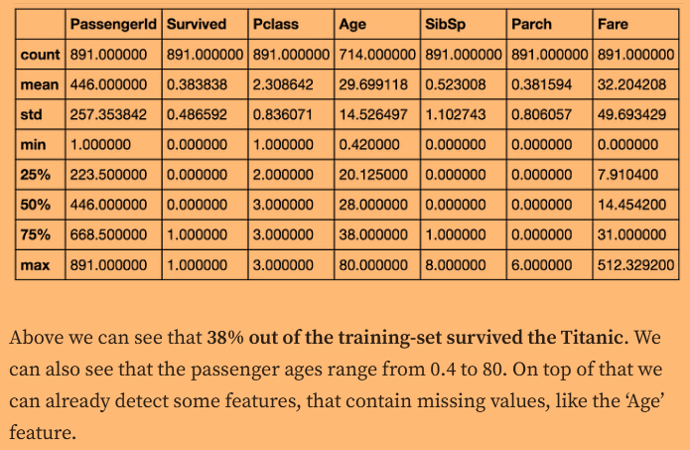
Exploratory Data Analysis (EDA)
The Titanic was carrying passengers of different ages, genders, and social classes. We will analyze the dataset to determine how these demographics were distributed among the passengers and what impact it had on their survival rates
The training-set has 891 examples and 11 features + the target variable (survived). 2 of the features are floats, 5 are integers and 5 are objects. Below I have listed the features with a short description:.

Slide 4
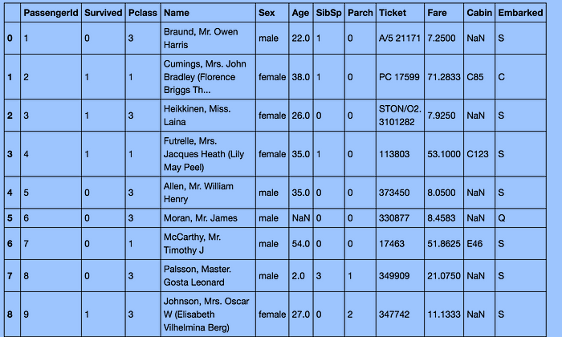
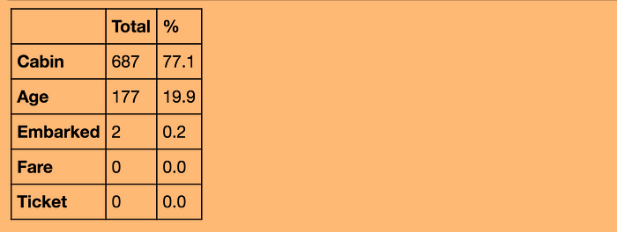
Data Preprocessing
we need to convert a lot of features into numeric ones later on, so that the machine learning algorithms can process them. Furthermore, we can see that the features have widely different ranges, that we will need to convert into roughly the same scale. We can also spot some more features, that contain missing values (NaN = not a number), that wee need to deal with.
Let’s take a more detailed look at what data is actually missing:
Cabin :- 77.1%
Age :- 19.9%
Embarked:- 0.2%

Slide 5
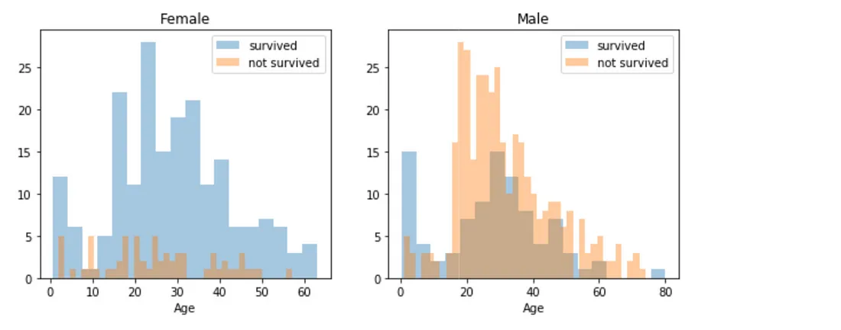
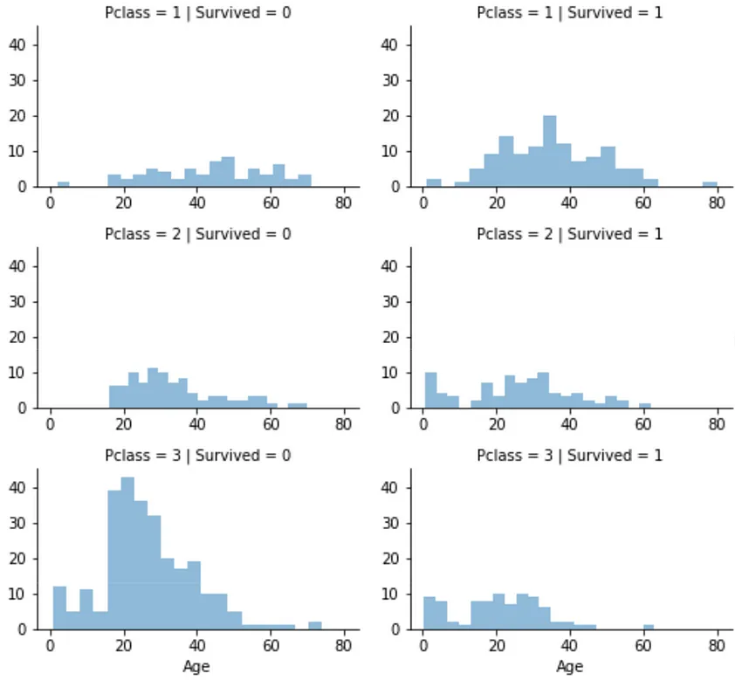
Data Visualisation
1. Age and Sex:
2. Pclass:

Slide 6
Model Selection
There are 6 steps to select a model and the are:-
Define the problem:
Identify potential models:
Split the dataTrain and evaluate models
Select the best-performing model
Validate the final model

Slide 7
Model Validation and Interpretation
The chosen model for predicting Titanic survivors is a decision tree.
The interpretability of the model can inform decision-making and provide insights to stakeholders.
The decision tree model has strengths in interpretability but may have limitations in capturing complex interactions or handling noise.
The decision tree model with 92% accuracy and interpretability is a valuable tool for understanding and predicting survival outcomes in the Titanic context.

Slide 8
Conclusion
Predicting Titanic survivors using machine learning allows us to accurately estimate the likelihood of survival for passengers.
The model's interpretability provides insights into the factors influencing survival, such as passenger class, age, and gender.
Further exploration and validation, including cross-validation or applying the model to new datasets, will enhance its reliability.
By leveraging machine learning techniques, we gain valuable insights into historical events and improve our understanding of complex phenomena.

Slide 9
Thank You
Kaggle: Online community and platform for data science and machine learning.
GitHub: Web-based platform for version control and collaboration, commonly used for hosting code repositories.
Chat GPT: OpenAI's Chatbot model used for providing information and assistance in this presentation.

